Slide 1


Digital Logic and Design

Slide 2


Slides can be found at
https://github.com/sajjo79/Digital-Logic-Design

Slide 3
Storage Elements: D Latch
Chapter 4: FlipFlops

Slide 4
Introduction
Flipflop is a storage element that can store binary information
The state of a flip-flop is switched by a change in the control input.
This momentary change is called a trigger, and the transition it causes is said to trigger the flip-flop.
The D latch with pulses in its control input is essentially a flip-flop
D Latch is triggered every time the pulse goes to the logic-1 level.
As long as the pulse input remains at this level, any changes in the data input will change the output and the state of the latch.
Input
Combinational Circuit
Output
Flipflop

Slide 5
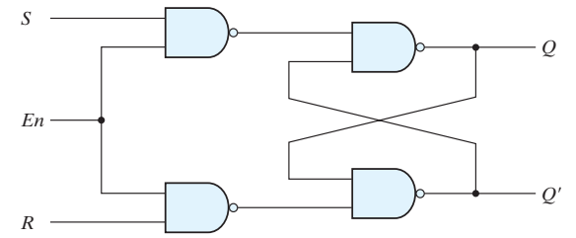
Introduction
State transition of latches start as soon as the clk changes to the logic-1 level
The new state of a latch appears at the output while the pulse is still active.
This output is connected to the inputs of the latches through the combinational circuit.
If the inputs applied to the latches change while the clock pulse is still at the logic-1 level, the latches will respond to new values and a new output state may occur.
The result is an unpredictable situation, since the state of the latches may keep changing for as long as the clock pulse stays at the active level.
If there are multiple latches and all are triggered with common clock than due to this the output of a latch cannot be applied directly or through combinational logic to the input of the same or another latch
The problem with the latch is that it responds to a change in the level of a clock pulse

Slide 6

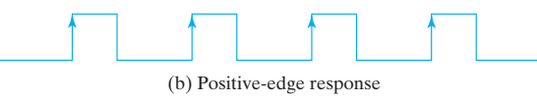
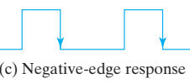
Flip-Flops
The issue faced by latches when common clock is used is eliminated in flip-flops
The key to the proper operation of a flip-flop is to trigger it only during a signal transition.
This can be accomplished by eliminating the feedback path that is inherent in the operation of the sequential circuit using latches.
A clock pulse goes through two transitions: from 0 to 1 and the return from 1 to 0.
The positive transition is defined as the positive edge and the negative transition as the negative edge.
There are two ways that a latch can be modified to form a flip-flop.
Employ two latches in a special configuration that isolates the output of the flip-flop and prevents it from being affected while the input to the flip-flop is changing.
Produce a flip-flop that triggers only during a signal transition (from 0 to 1 or from 1 to 0) of the synchronizing signal (clock) and is disabled during the rest of the clock pulse.

Slide 7
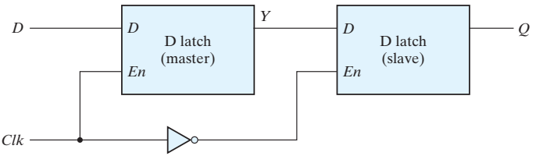
Edge-Triggered D Flip-Flop
A D flip-flop with two D latches and an inverter is shown in Fig.
The first latch is called the master and the second the slave.
The circuit samples the D input and changes its output Q only at the negative edge of the synchronizing or controlling clock (designated as Clk).
If clock = 0: Master latch is disabled. Slave latch is enabled and Q=Y
Change in input D does not affect the state of Master
If clock = 1: Master is enabled and slave is disabled.
Change in input D affects the state of master
Hence when clock is triggered to 1, master state is changed if D=1 and when clock is triggered to zero, salve is enabled and change in master is propagated to salve

Slide 8
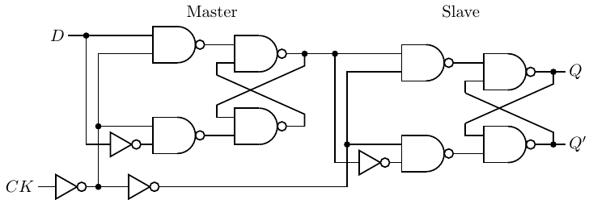
Edge Triggered D Flip Flop
The behavior of the master–slave flip-flop dictates that (negative edge triggered flipflop)
The output may change only once
A change in the output is triggered by the negative edge of the clock
The change may occur only during the clock’s negative level.
Positive edge triggered flip flop can also be designed
This uses an additional inverter between the Clk terminal and the junction between the other inverter and input En of the master latch.

Slide 9
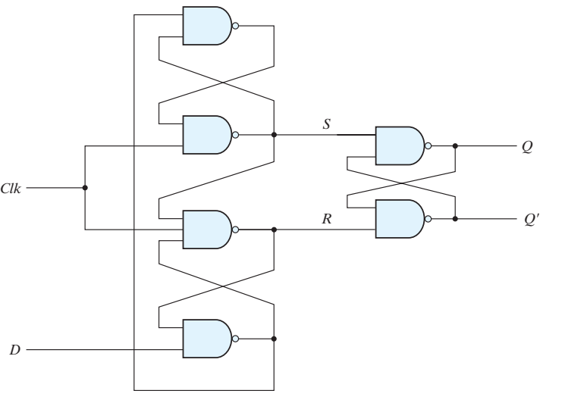
2nd Construction of Flip Flop
This uses three SR latches as shown in Fig
Two latches respond to the external D (data) and Clk (clock) inputs. The third latch provides the outputs for the flip-flop.
The S and R inputs of the output latch are maintained at logic-1
Stable State: clk =0, D=x → output remains in current state
Reset State: clk=1, D=0 → R=0 and Q=0
Clk=1, D=1: terminal R remains at 0 because Q=0
The flip-flop is locked out and is unresponsive to further changes in the input.
When the clock returns to 0, R goes to 1, placing the output latch in the quiescent condition without changing the output.
Similarly, if D = 1 when Clk goes from 0 to 1, S changes to 0.
This causes the circuit to go to the set state, making Q = 1. Any change in D while Clk = 1 does not affect the output.

Slide 10
Summary
when the input clock in the positive-edge-triggered flip-flop makes a positive transition, the value of D is transferred to Q.
A negative transition of the clock (i.e., from 1 to 0) does not affect the output, nor is the output affected by changes in D when Clk is in the steady logic-1 level or the logic-0 level.
Hence, this type of flip-flop responds to the transition from 0 to 1 and nothing else.

Slide 11
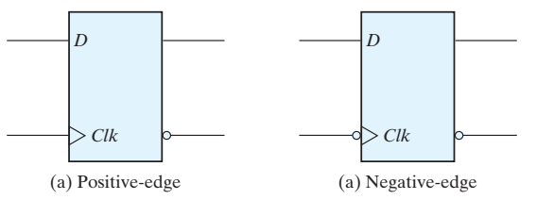
For edge triggered flip-flop, the timing of the response of a flip-flop to input data and to the clock must be taken into consideration
There is a minimum time called the setup time during which the D input must be maintained at a constant value prior to the occurrence of the clock transition.
There is a minimum time called the hold time during which the D input must not change after the application of the positive transition of the clock.
The propagation delay time of the flip-flop is defined as the interval between the trigger edge and the stabilization of the output to a new state.
These and other parameters are specified in manufacturers’ data books for specific logic families.

Slide 12
12
Thanks for watching
Dr. Sajid Iqbal
Assistant Professor
Department of Computer Science
Bahauddin Zakariya University, Multan
Allah Hafiz
Slides are available at: https://github.com/sajjo79/Digital-Logic-Design

